Slide 1


Slide 2

Learn SQL in Arabic 2020

Slide 3

Who is this Course for?
Anyone who wants to learn DBs in general
Mostly for software developers

Slide 4
What you will learn?
The basics of sql
Creating databases
CRUD operations
Constraints
Alters
Clauses (where, order by, group by)
Joins
Wild cards
Functions
Triggers
And so much more

Slide 5
What is a database?
Is nothing more than a container for data
A database can be simpler than you think
There are various types of databases
DBs are really great for storing data

Slide 6
What is the difference between SQl and MYSQL?
SQL stands for structured query language
It’s the standard language for creating DBs
MYSQL is a RDMS
A software used for creating and managing DBs

Slide 7
What are some popular DBs?
MYSQL
MS SQL Server
Couch DB
Postgre SQL
SQL lite
ORACLE
Maria DB

Slide 8
SQL VS noSQL!
SQL organizes data into one or more tables
Each table has columns and rows
A unique key identifies each row
EX. MYSQL
noSQL organizes data in anything but a table
Key-value
DOCs (JSON-XML)
Graphs
Flexible Tables
Ex. MONGO DB

Slide 9
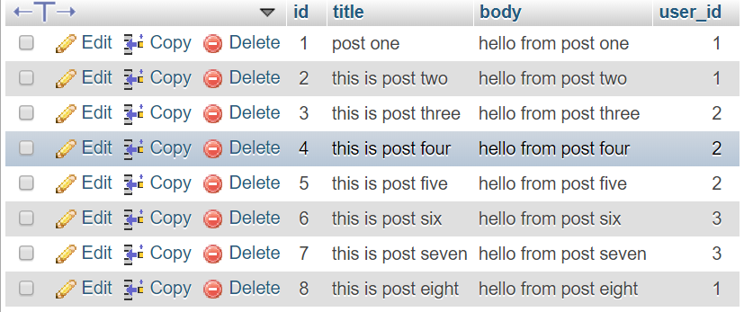
Tables, columns, rows and cells

Slide 10
What is a query?
Is a request to the database to get a specific piece of info
As the DB gets more complex, the query gets more complex to get that piece of info
EX. “SELECT * FROM DB_name”

Slide 11
What is CRUD?
Stands for create, read, update and delete
It is a common concept in SE
The basis of a lot apps

Slide 12
WRAP UP
This is it. If you have any questions, comment down or reach to me on my social media ☺

